Slide 1




S69 RBOT Strategy
1
2
RADWU
RADIOMCAL
DFPW
RSSP
RSSK
RSS OCC ORT
DFPW
3
DFPWPEM
PEM-A
DFPW
R
R
R
R
3 hr Roll
Roll/SRU
5 hr Roll
Roll/SRU
RSS2RWAF
OCC ORT
DFPW
4
5
RSSK
OCC ORT
DFPW
6
RSSP
RSSK
USO PIM
DFPW
7
5 hr Roll
R
R
R
R
R
6 hr Roll
Ka Down
Ka Down
8
9
RSS3 OCC
Roll/SRU
5 hr Roll
Roll/SRU
5 hr Roll
R
R
10
11
R
R
R
Roll/SRU
Roll/SRU
Roll/SRU
Roll/SRU
12
13
14
OTM-288
OTM-288a
4 hr Roll
4 hr Roll
Roll/SRU
R
R
R
R
R
R
15
Grail Launch
251-276!
Dust
OTM-289
Titan 78
5821.4 km Inbound
Open
cover
OTM-290

Slide 2
Notes
Bias windows have been expanded to include Y-bias turns
Some segments end or begin in low rpm. This is right before or after a Y-bias, and the wheels do not stay in this region for long.

Slide 3
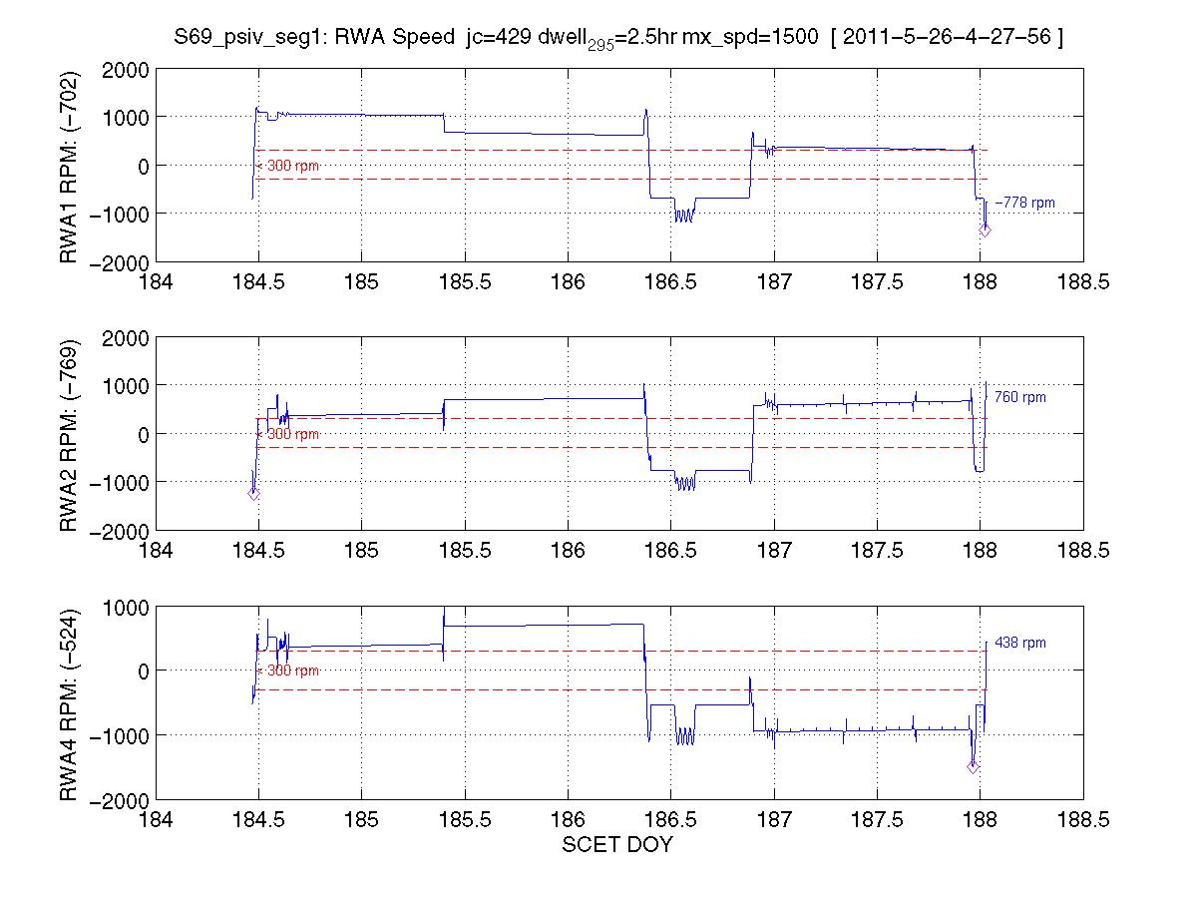
Segment 1: fuel-optimized starting solution: CLEAN
With small change to starting rpm
DOY 184
DOY 188 Y-bias

Slide 4
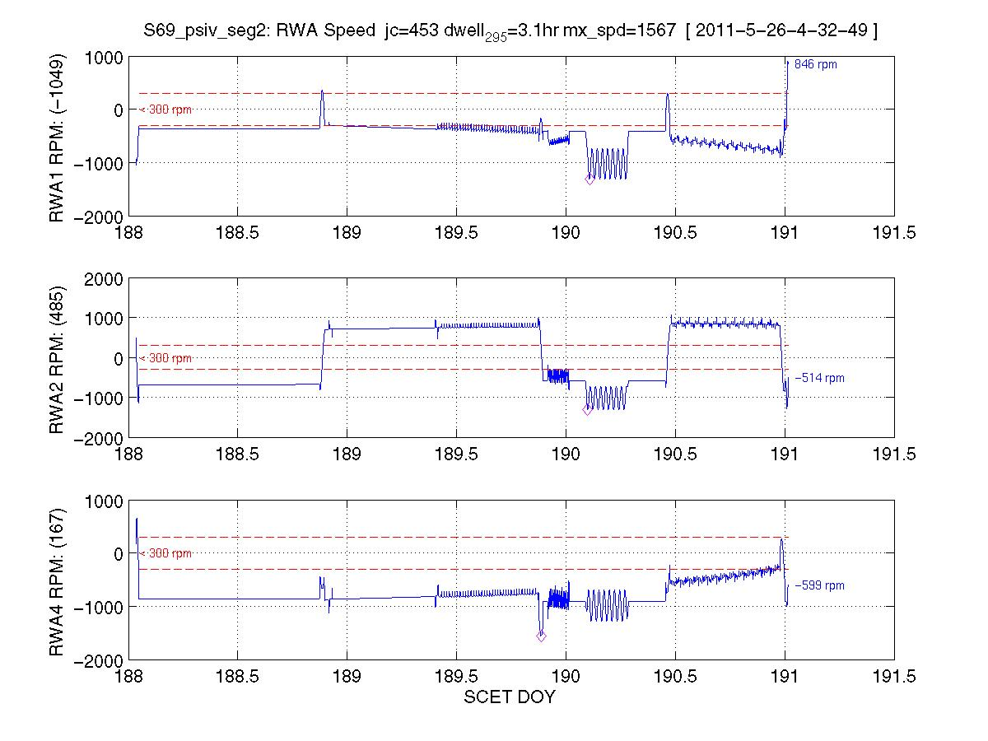
Segment 2: all fixes incorporated
DOY 191 Y-bias
DOY 188

Slide 5
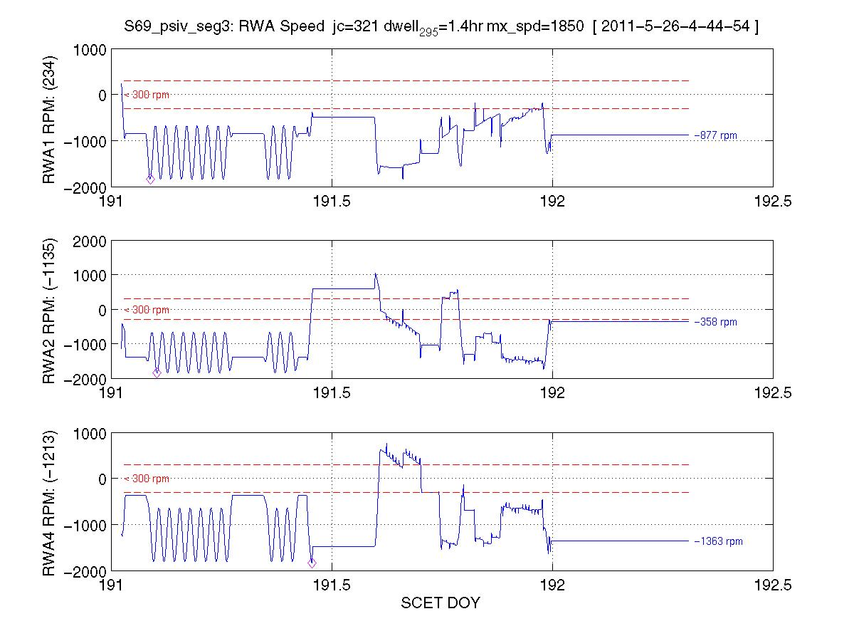
7
Segment 3: all fixes incorporated
DOY 191
DOY 192

Slide 6
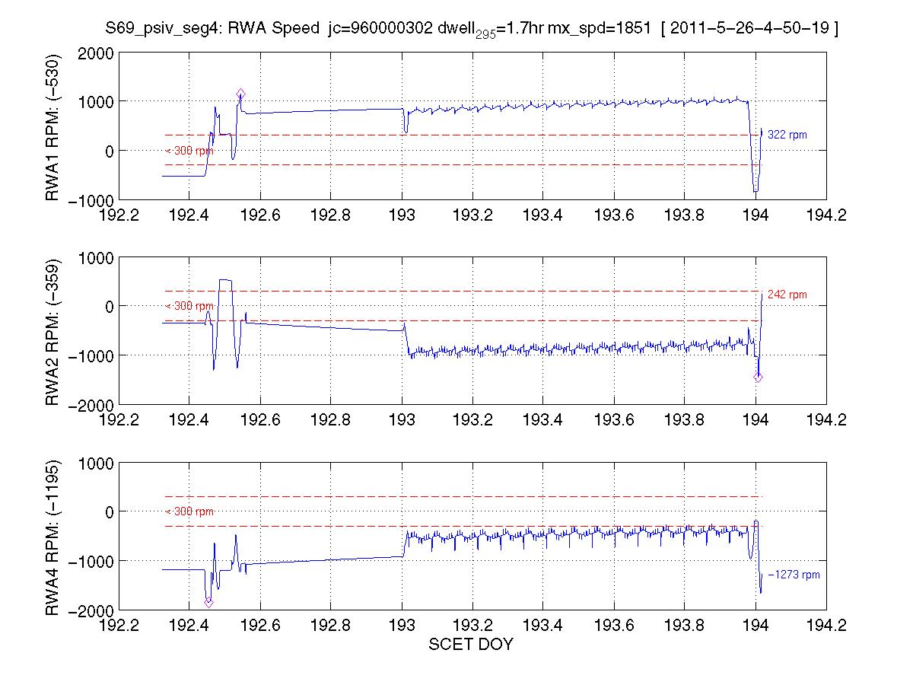
Segment 4: all fixes incorporated
DOY 194 Y-bias
DOY 192

Slide 7
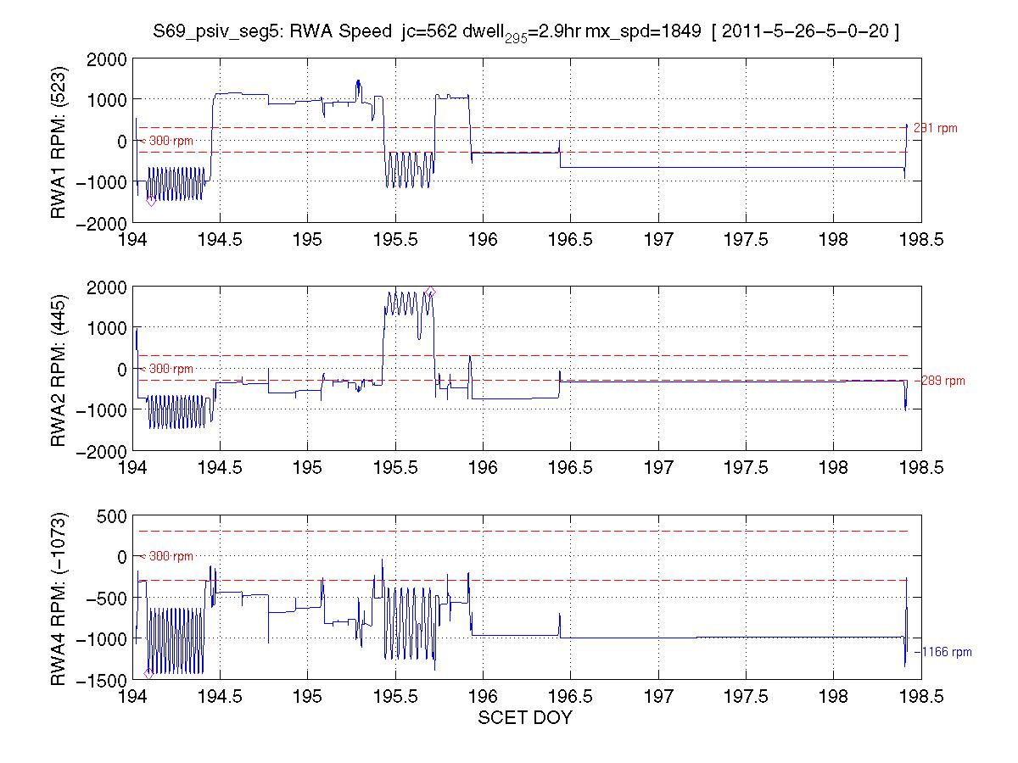
Segment 5: all fixes incorporated
DOY 198 Y-bias
DOY 194

Slide 8
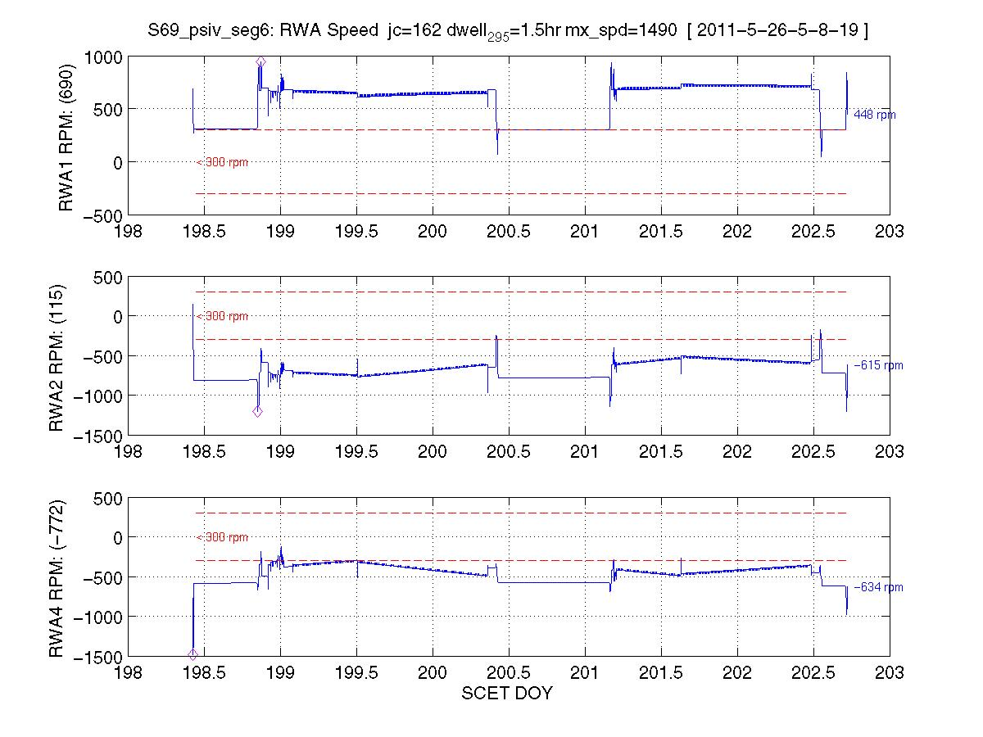
Segment 6: fuel-optimized starting solution: CLEAN
DOY 202 Y-bias
DOY 198

Slide 9
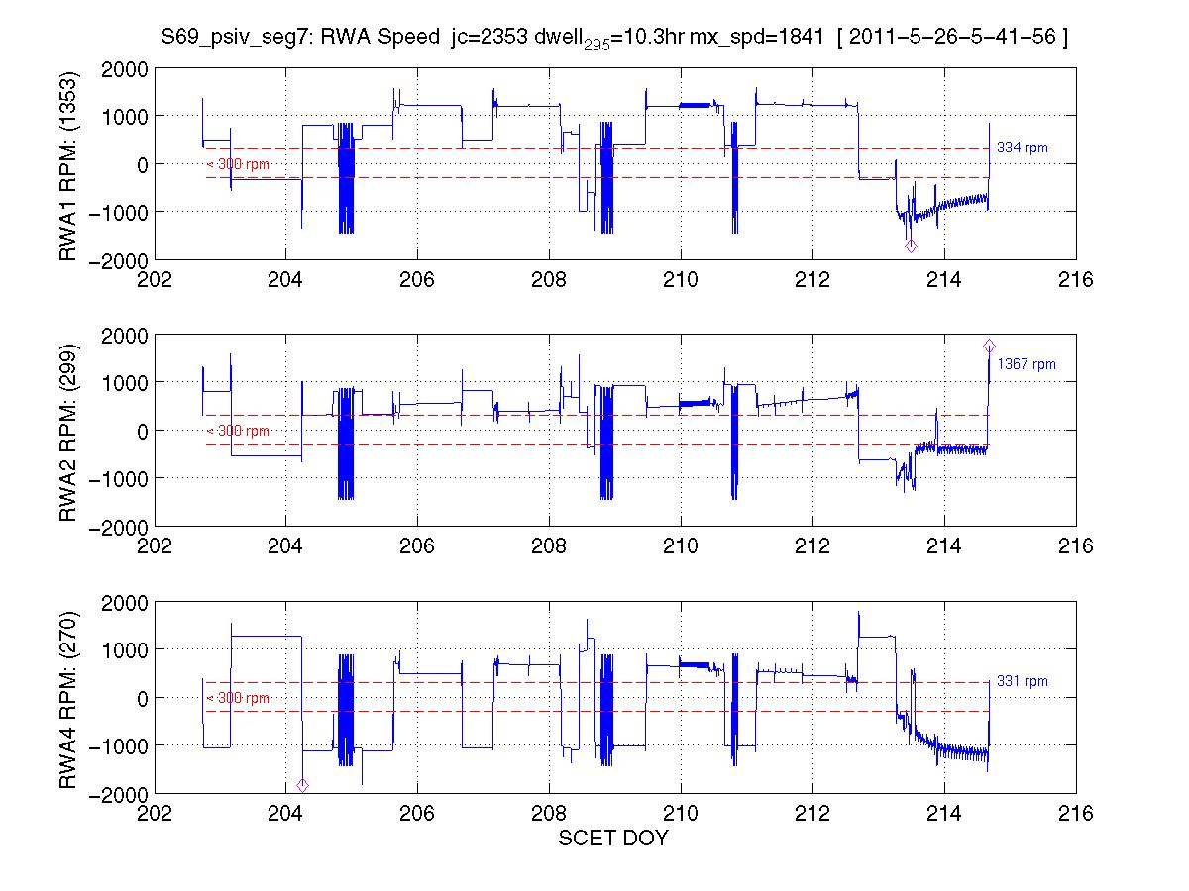
Segment 7: all fixes incorporated
DOY 214 Y-bias
DOY 202

Slide 10
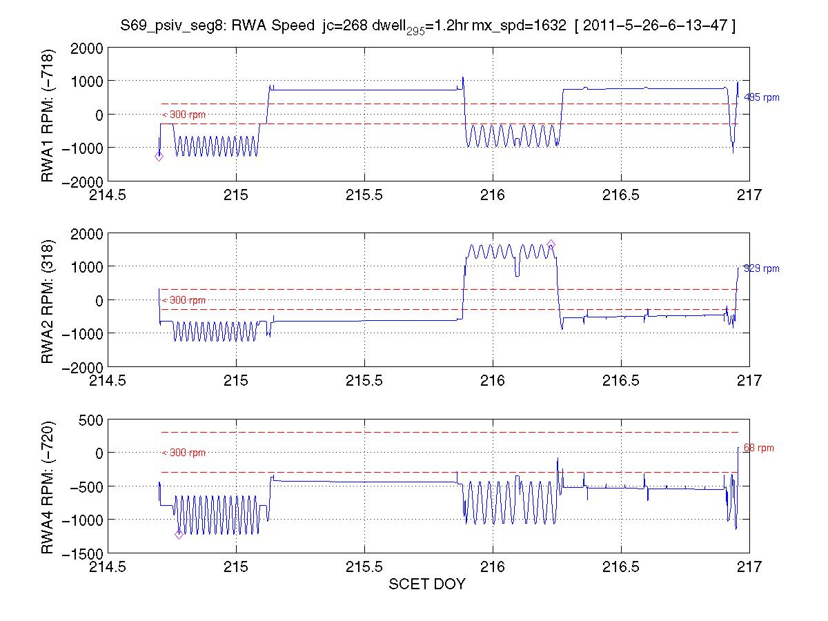
Segment 8: all fixes incorporated
DOY 216 Y-bias
DOY 214

Slide 11
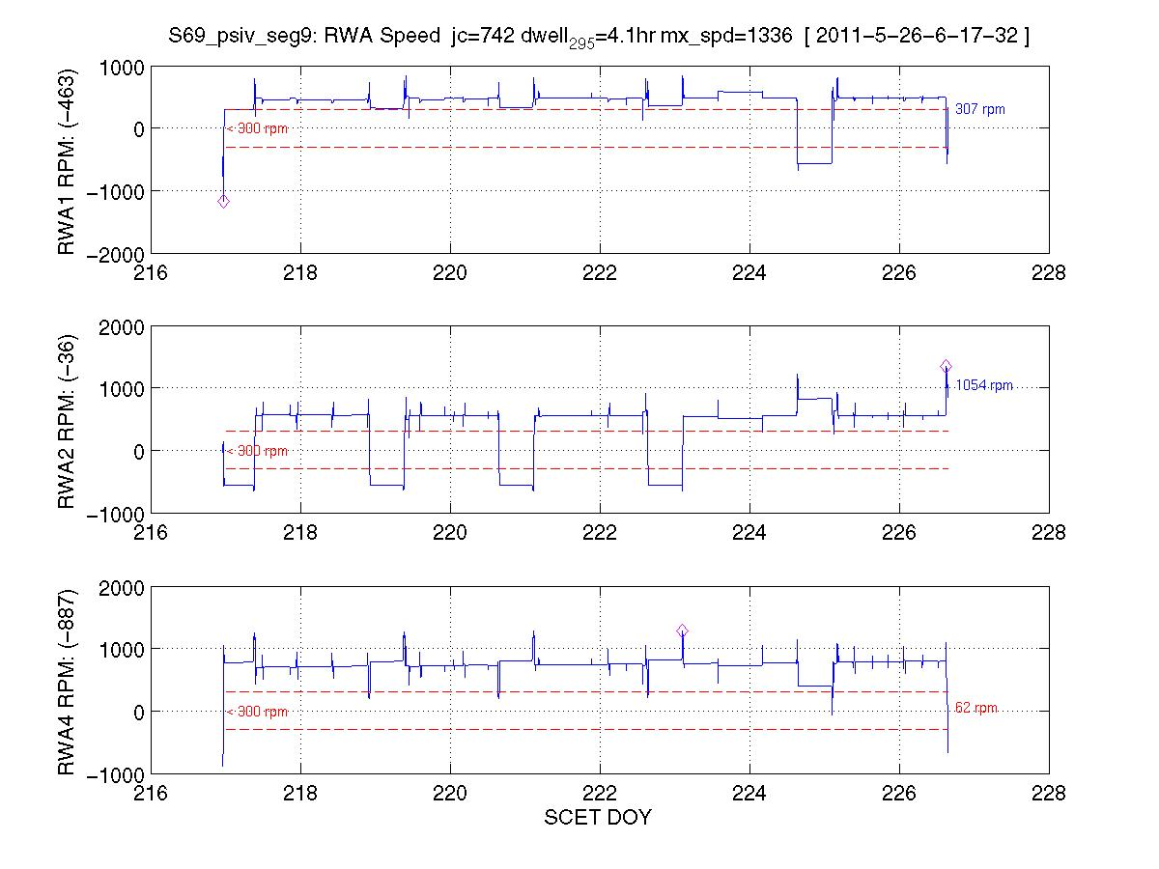
7
Segment 9: optimal bias solution: CLEAN
DOY 226 Y-bias
DOY 217

Slide 12
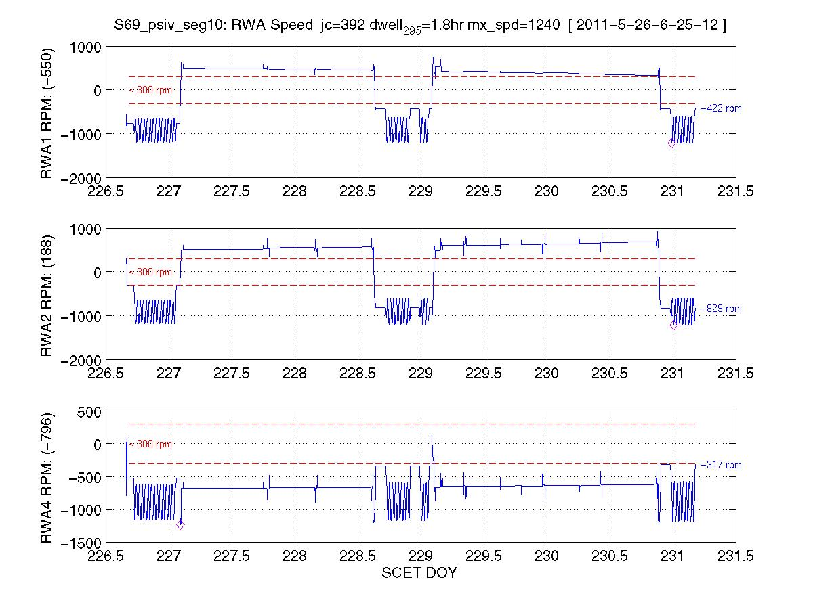
Segment 10: optimal starting solution : CLEAN
DOY 226
DOY 230

Slide 13
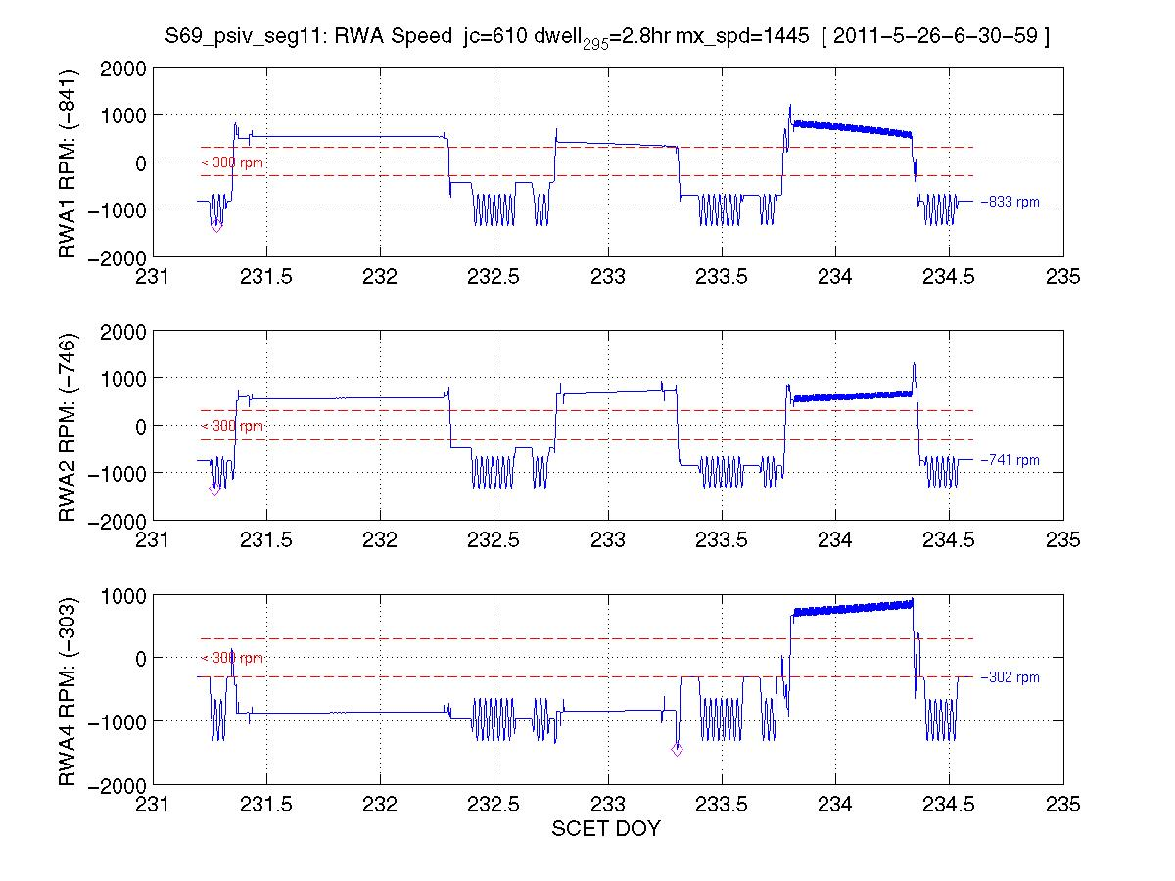
Segment 11: optimal starting solution : CLEAN
DOY 230
DOY 234

Slide 14
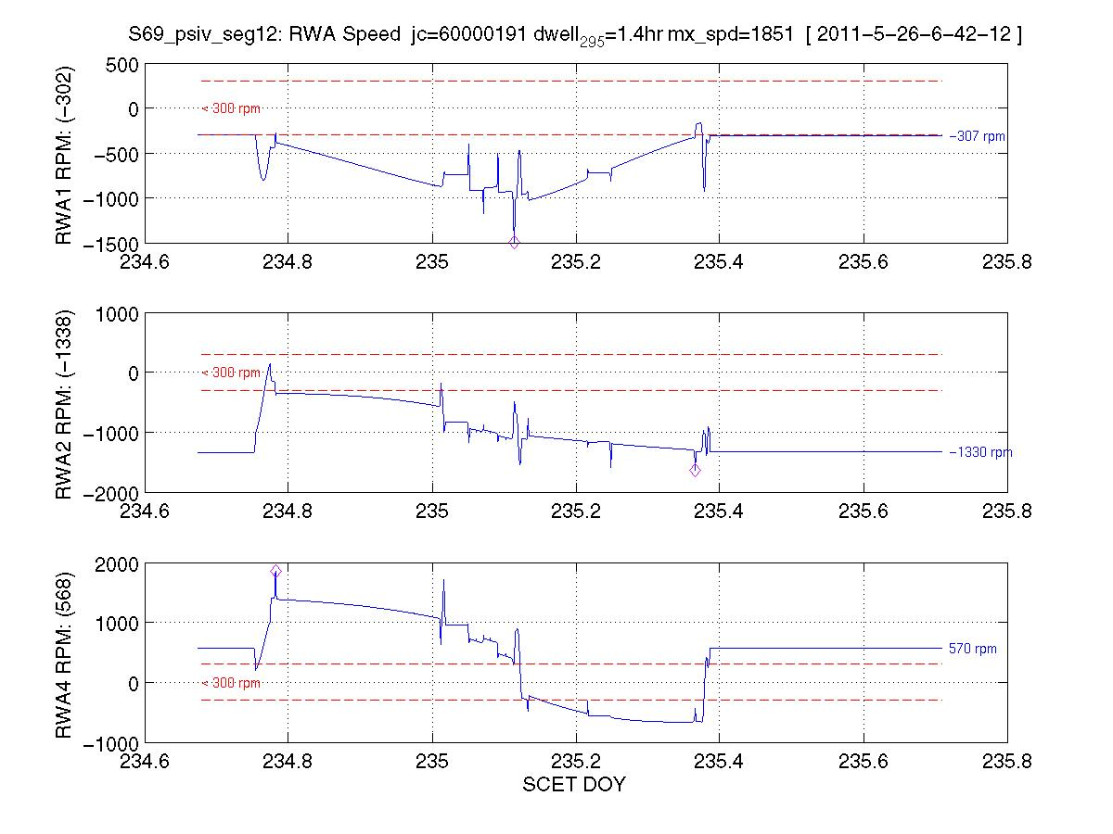
v
Segment 12: all fixes incorporated
DOY 234
DOY 235

Slide 15
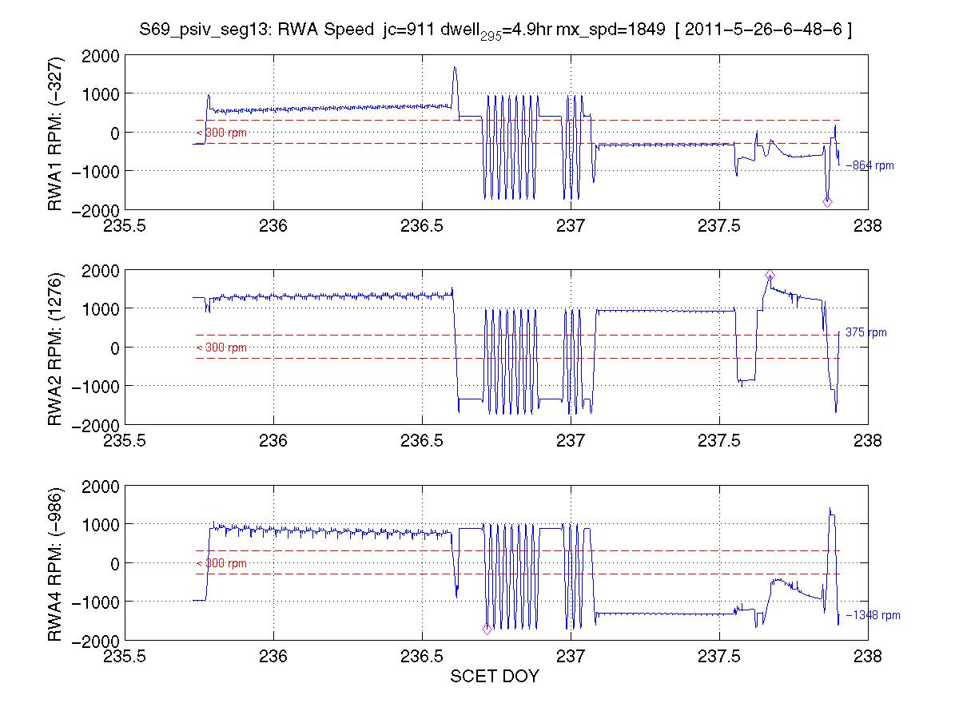
Segment 13: all fixes incorporated
DOY 237 Y-bias
DOY 235

Slide 16
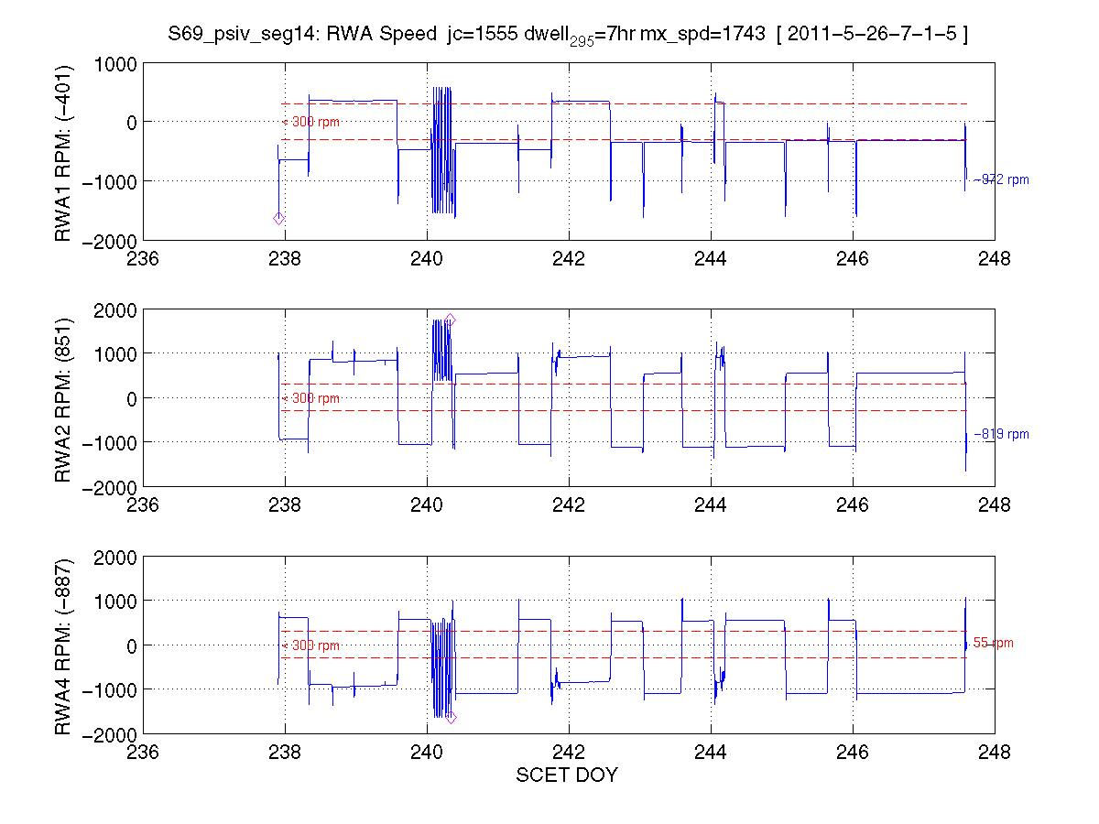
Segment 14: optimal starting solution : CLEAN
DOY 247 Y-bias
DOY 237

Slide 17
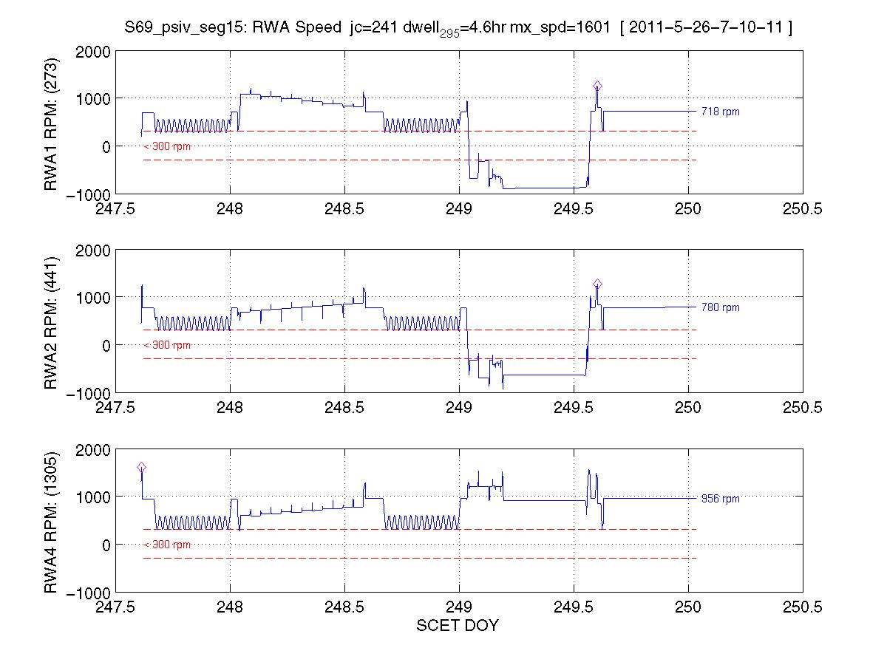
Segment 15:nearly-optimal starting solution : CLEAN
DOY 247
End of Sequence

