Slide 1
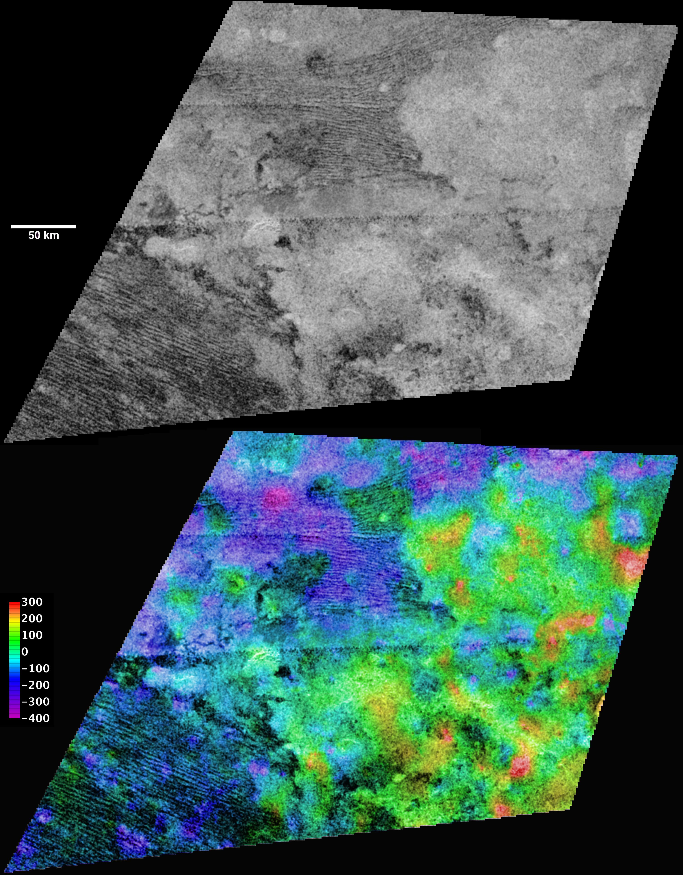
Titan Observations
Titan was systematically targeted throughout the Cassini mission. Observations have been planned to span the period from July 2, 2004 to Apr 22, 2017. Tables are available containing information concerning targeted and non-targeted flybys, solar and earth occultations(See observer’s log) and graphics presenting information concerning observational sequences for the prime, equinox and solstice missions.
Image PIA11829.jpg
http://photojournal.jpl.nasa.gov/
Observations were made by:
CIRS - Composite Infrared Spectrometer
INMS – Ion and Neutral Mass Spectrometer
ISS - Imaging Science Subsystem
Radar - a Radar instrument
RSS – Radio Science
UVIS - Ultraviolet Imaging Spectrograph
VIMS - Visual and Infrared Mapping
Spectrometer

