Slide 1
Calibration files
A table of calibrated calibration files (1) and access to the Calibration Collection http://atmos.nmsu.edu/PDS/data/PDS4/MAVEN/iuvs_calibrated_bundle/calibration/centroid/
Cruise Phase Collection
This collection contains data products from the IUVS observations made during the cruise phase of the MAVEN mission from Nov 18, 2013 through Sep 21, 2014. These include the initial instrument checkout, a campaign that attempted to observe comet C/2012 S1 (ISON) after periapsis, several months of observing interplanetary hydrogen, and two calibration sequences based on observations of stars and Mars.
RAW Data
http://atmos.nmsu.edu/PDS/data/PDS4/MAVEN/iuvs_raw_bundle/l1a/cruise/
Calibrated Data
http://atmos.nmsu.edu/PDS/data/PDS4/MAVEN/iuvs_calibrated_bundle/l1b/cruise/
The Transition Collection
The transition collection contains data products from the IUVS observations made during the transition phase of the MAVEN mission between Mars Orbital Insertion (MOI) on Sep 21, 2014 and the start of nominal science operations in November 2014. These include two APP calibration sequences, a 1 orbit campaign to observe comet C/2013 A1 (Siding Spring).
Raw Data
http://atmos.nmsu.edu/PDS/data/PDS4/MAVEN/iuvs_raw_bundle/l1a/transition/
Calibrated Data
http://atmos.nmsu.edu/PDS/data/PDS4/MAVEN/iuvs_calibrated_bundle/l1b/transition/

Slide 2
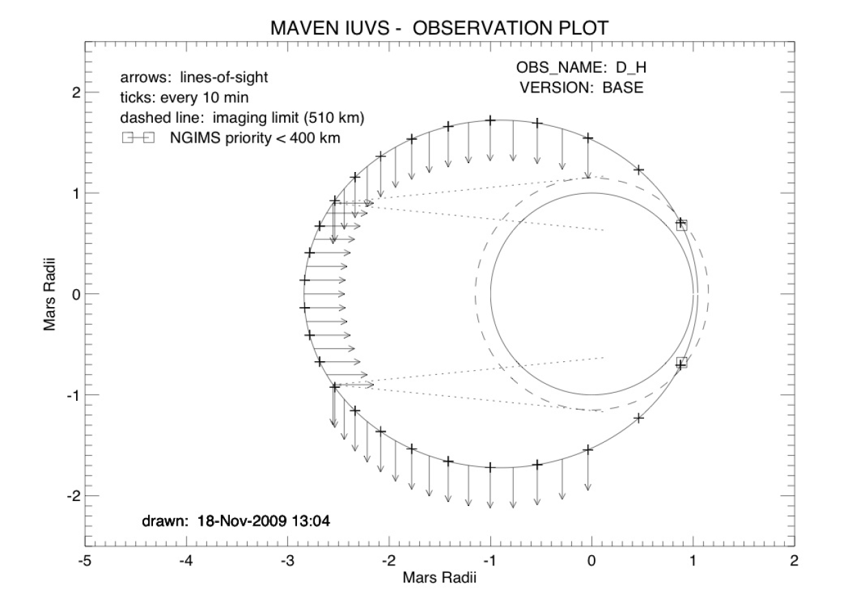
The Corona Collection
The corona data collection contains data products for coronal scans of the extended Martian atmosphere during the side segments of the MAVEN orbit when IUVS has pointing priority. From orbit to orbit when IUVS has priority, it alternates between the low spectral resolution coronal scan mode and the echelle mode. The coronal scans have three distinct components: scanning while outbound above the Martian limb, inbound above the limb, and inbound below the limb (when the planet intersects instrument line-of-sight projected backward).
Raw Data
http://atmos.nmsu.edu/PDS/data/PDS4/MAVEN/iuvs_raw_bundle/l1a/corona/
Calibrated Data
A Log (2) containing URN, orbit, wavelength interval and time can be used to select specific files
http://atmos.nmsu.edu/PDS/data/PDS4/MAVEN/iuvs_calibrated_bundle/l1b/corona/
Processed data
A Log (3) containing URN, orbit, wavelength interval and time can be used to select specific files.
http://atmos.nmsu.edu/PDS/data/PDS4/MAVEN/iuvs_processed_bundle/l1c/corona/
In addition to the above files the Mission Time Line (11) can be used to select time intervals through the following time interval retrieval.
TIME RETRIEVAL BOX
Coronal scan observation geometry

Slide 3
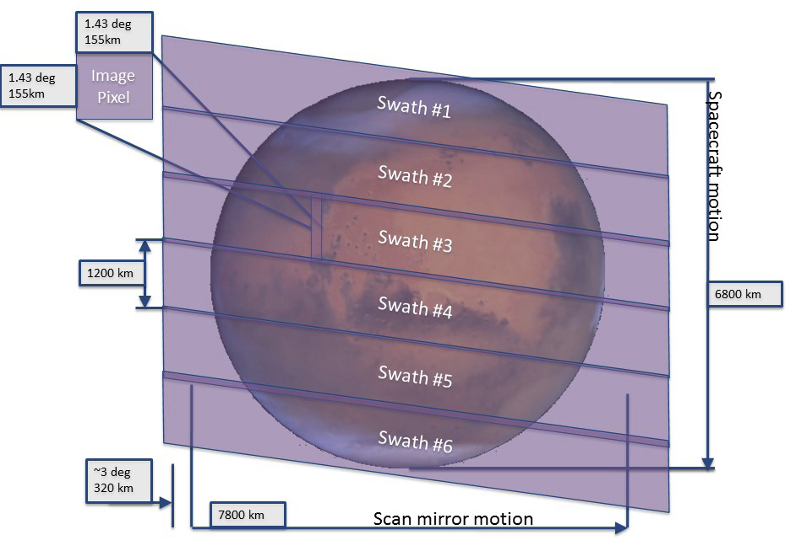
The Disk Collection
The iuvs.<bundle ID>:disk data collection contains data products for imaging of the Martian disk. During the apoapse segment of MAVEN’s orbit the IUVS scan mirror traces out eight swaths that cover the entire disk and above the limb to 500 km or higher. A single swath is also taken during the outbound side segment of the orbit while IUVS is pointing at the disk.
Raw Data
http://atmos.nmsu.edu/PDS/data/PDS4/MAVEN/iuvs_raw_bundle/l1a/disk/
Calibrated Data
A Log (4) containing URN, orbit, wavelength interval and time can be used to select specific files.
http://atmos.nmsu.edu/PDS/data/PDS4/MAVEN/iuvs_calibrated_bundle/l1b/disk/
Processed data
A Log (5) containing URN, orbit and time can be used to select specific files.
http://atmos.nmsu.edu/PDS/data/PDS4/MAVEN/iuvs_calibrated_bundle/l1b/disk/
In addition to the above files the Mission Time Line (11) can be used to select time intervals through the following time interval retrieval.
TIME RETRIEVAL BOX
Apoapse disk imaging observation geometry
(actual observations have 8 swaths)

Slide 4
The Echelle Collection
The echelle data collection contains data products for scans taken during the side segments of the MAVEN orbit when IUVS has pointing priority. From orbit to orbit when IUVS has priority, it alternates between the echelle mode and the low spectral resolution corona mode.
Raw
http://atmos.nmsu.edu/PDS/data/PDS4/MAVEN/iuvs_raw_bundle/l1a/echelle/
Calibrated Data
A Log (6) containing URN, cycle, mode and time can be used to select specific files.
http://atmos.nmsu.edu/PDS/data/PDS4/MAVEN/iuvs_calibrated_bundle/l1b/echelle/
In addition to the above files the Mission Time Line (11) can be used to select time intervals through the following time interval retrieval.
TIME RETRIEVAL BOX

Slide 5
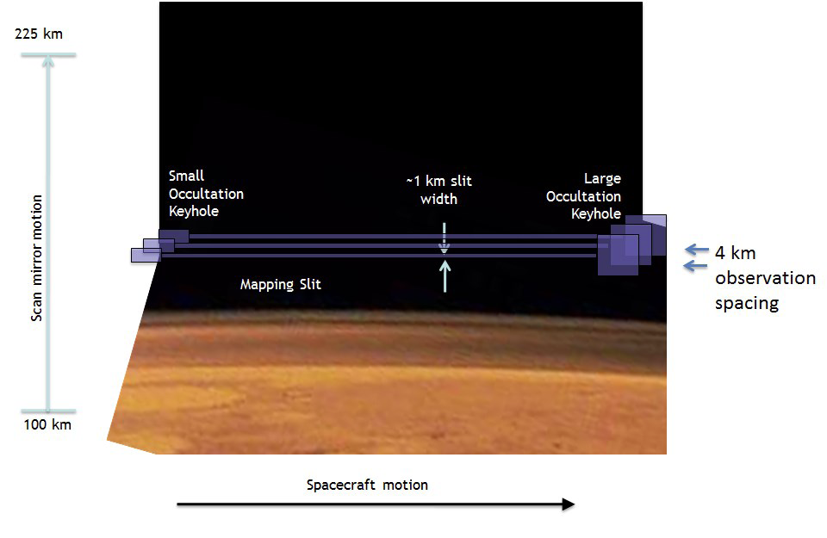
The Limb Collection
The limb data collection contains data products for limb scan observations of the Martian thermosphere. Each limb scan is composed of multiple integrations from the IUVS. At periapsis there are twelve vertical limb scan profiles during orbits where IUVS has pointing priority. An additional limb scan is obtained during the outbound side segment of the MAVEN orbit. Each limb scan aims to include the range of 100-200 km, with a vertical resolution of at least 4 km.
Raw
http://atmos.nmsu.edu/PDS/data/PDS4/MAVEN/iuvs_raw_bundle/l1a/limb/
Calibrated Data
A Log (7) containing URN, orbit, wavelength interval and time can be used to select specific files.
http://atmos.nmsu.edu/PDS/data/PDS4/MAVEN/iuvs_calibrated_bundle/l1b/limb/
Processed data
A Log (8) containing URN, orbit, wavelength interval and time can be used to select specific files.
http://atmos.nmsu.edu/PDS/data/PDS4/MAVEN/iuvs_processed_bundle/l1c/limb/
In addition to the above files the Mission Time Line (11) can be used to select time intervals through the following time interval retrieval.
TIME RETRIEVAL BOX
Limb scan observation geometry
http://atmos.nmsu.edu/PDS/data/PDS4/MAVEN/iuvs_processed_bundle/l1c/limb/

Slide 6
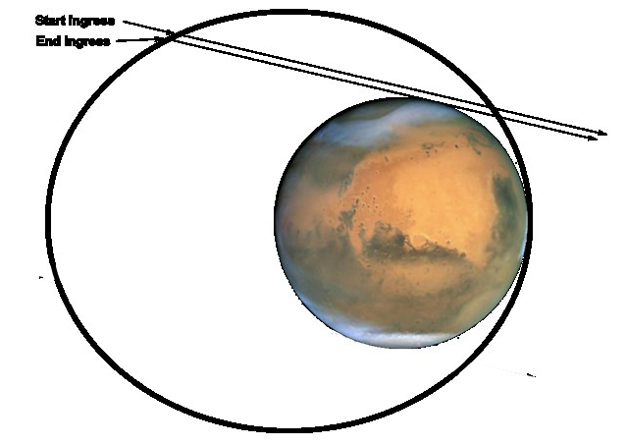
Stellar Occultation Collection
Stellar occultation campaigns are carried out at specific times (See Occultation Listing (10) for details of specific campaigns).
Raw
http://atmos.nmsu.edu/PDS/data/PDS4/MAVEN/iuvs_raw_bundle/l1a/occultation/
Calibrated Data
A Log (7) containing URN, orbit, wavelength range and time can be used to select specific files.
http://atmos.nmsu.edu/PDS/data/PDS4/MAVEN/iuvs_calibrated_bundle/l1b/occultation/
In addition to the above files the Mission Time Line (11) can be used to select time intervals through the following time interval retrieval.
TIME RETRIEVAL BOX
The geometry of an ingress observation

